Slide 1

Customer Portal
UX Ramp Up

Slide 2
Key Themes
Core functionality seems to fall into four areas...
Forms
Dynamic forms where a user can request or enquiry about a facility / service. That form is routed to the correct recipient/s.
Data
Displaying fixed content from a database.
CMS Content
‘Content’ created within the CMS system which is then distributed to the portal and other marketing sites. PDF downloads may feature heavily here.
Ticketing
Raise an issue and track its progress to resolution.

Slide 3
Potential Themes
There are two more that might warrant inclusion...
Calendar
Some functionality may be better served by a real time availability calendar, where users can ‘self serve’ - book a facility or function via the calendar, amend appointments, delete them, and so forth with no Grainger intervention.
Alexa Skills
We’re currently building out a PoC for Alexa skills, allowing residents to query data using Amazon Alexa voice commands. This might be an attractive extra level of functionality to add to the project.

Slide 4
MMP Functional Areas
Calendar?
Delivery January 2019
Forms
Data
CMS Content
Ticketing
Move in Process
- Set/amend move in date - Book a home induction
- Rate your move in experience
Lease Information
- Make a payment
- Request cancellation of a payment
- Request to cancel a direct debit
- Request change/renew/cancel lease
- Request to change sharer/occupier
- Request to rent a parking space
- Request to cancel a parking space
Booking
- Reserve/amend/cancel a space
- Reserve/amend/cancel elevator
- Reserve/amend/cancel loading bay
- Obtain a parking permit
Account Administration
- Sign in to portal
- Forgotten password
- Change contact preferences
- Change email / phone details
Financial Data
- View payment schedule
- View balance
- View transaction history
- View direct debit instruction
- Display deposit information
Development Information
- Property manager details
- Contact concierge
- Contact us details
PDF Content - Direct debit amendment form
- Lease details
- Inventory documentation
- Tenancy documentation
- Handbook
- Pre move check in list
- Property instruction manuals
Content
- FAQ’s
- Property FAQ’s
- Building news and announcements
Events
- View upcoming events in building
- Report a fault ticket
- Cancel a fault request ticket
- View list of fault tickets
- Check fault ticket status
- Update a fault ticket
- Close a fault ticket

Slide 5
Post MMP Functional Areas
Calendar?
Delivery January - May 2019 (Out of Scope)
Forms
Data
CMS Content
Ticketing
Lease Information
- Request to end tenancy
- Request a change to my lease - Request a refresh/refurb of apartment
- Refer a friend
- Register a visitor
Booking
- Book a trainer
- Book dry cleaning - Book/amend/cancel a gym
Account Administration
- Change car registration details
- Update my persona data
Forums
- Discussion forum for residents
Contact
- Chat functionality
- Notifications for new enquiries
CMS Functionality
- Search content / events
- Remote viewing of properties
General
- View local services
- View utilities information/options
- Order home furnishing
- Upgrade internet/TV package
- Notify me I have a parcel
Events
- Events calendar
- Add events to my diary
- RSVP to an event
- Third party events
- Search events
- Track an engineer in real time
- View my engineers contact information
- One click contact my engineer
- View my appointment details
- Amend my appointment details

Slide 6
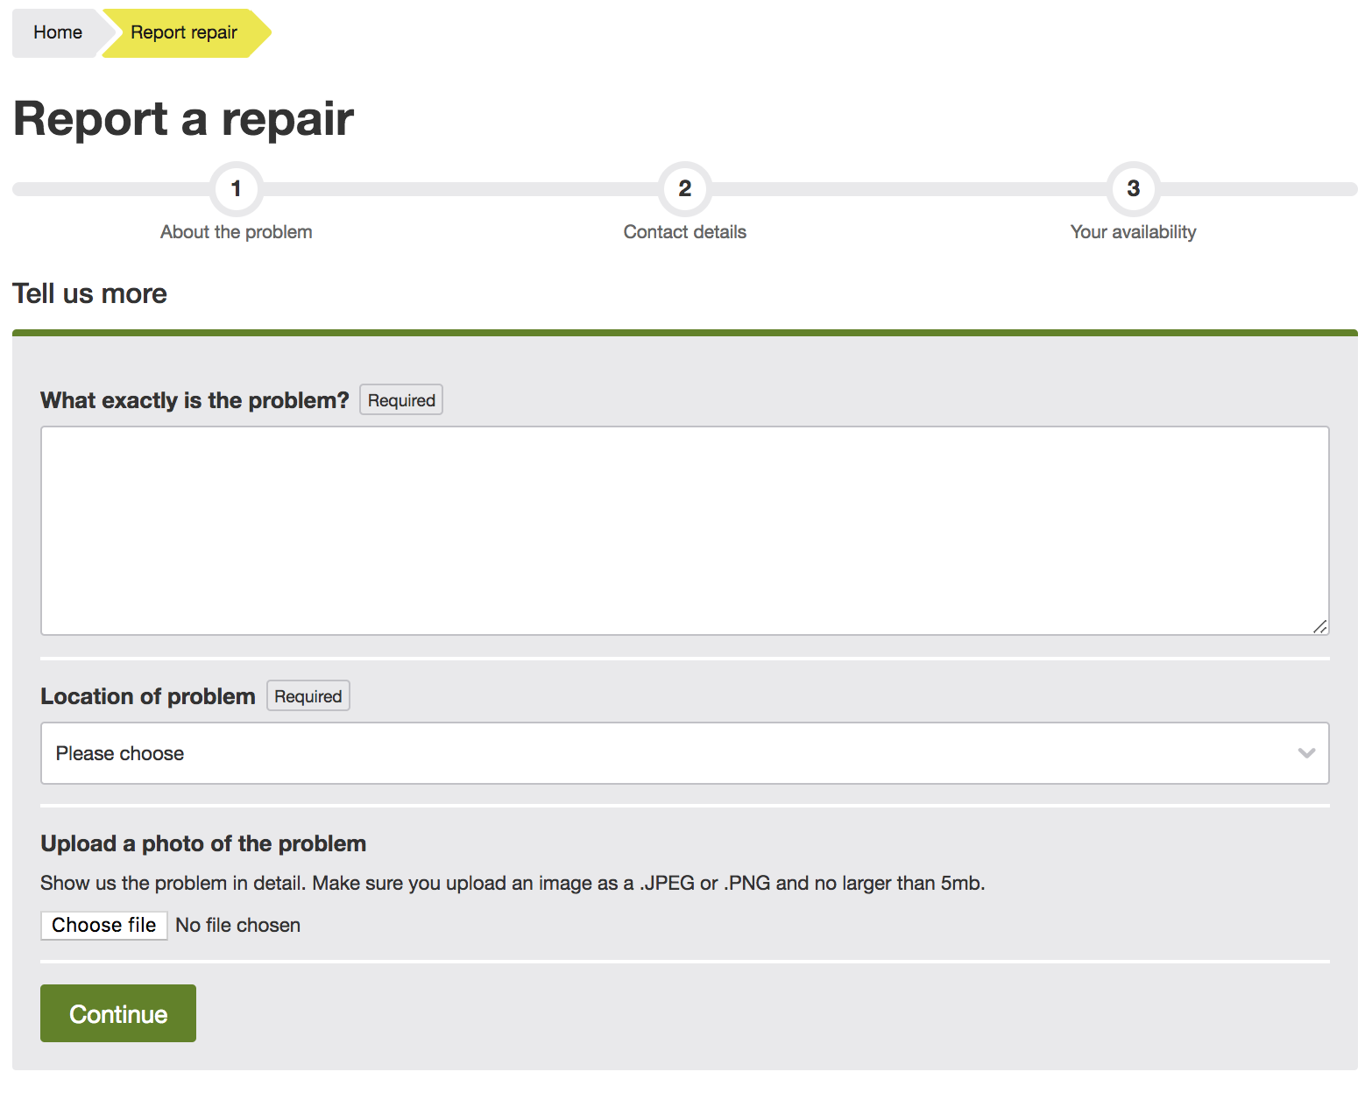
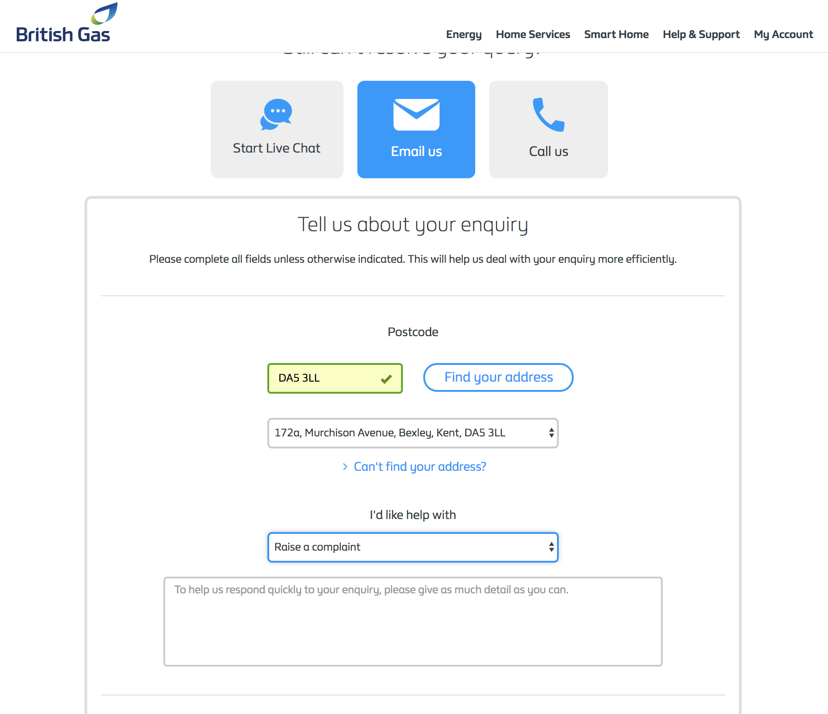
Form fields examples
L & Q Housing & British Gas

Slide 7
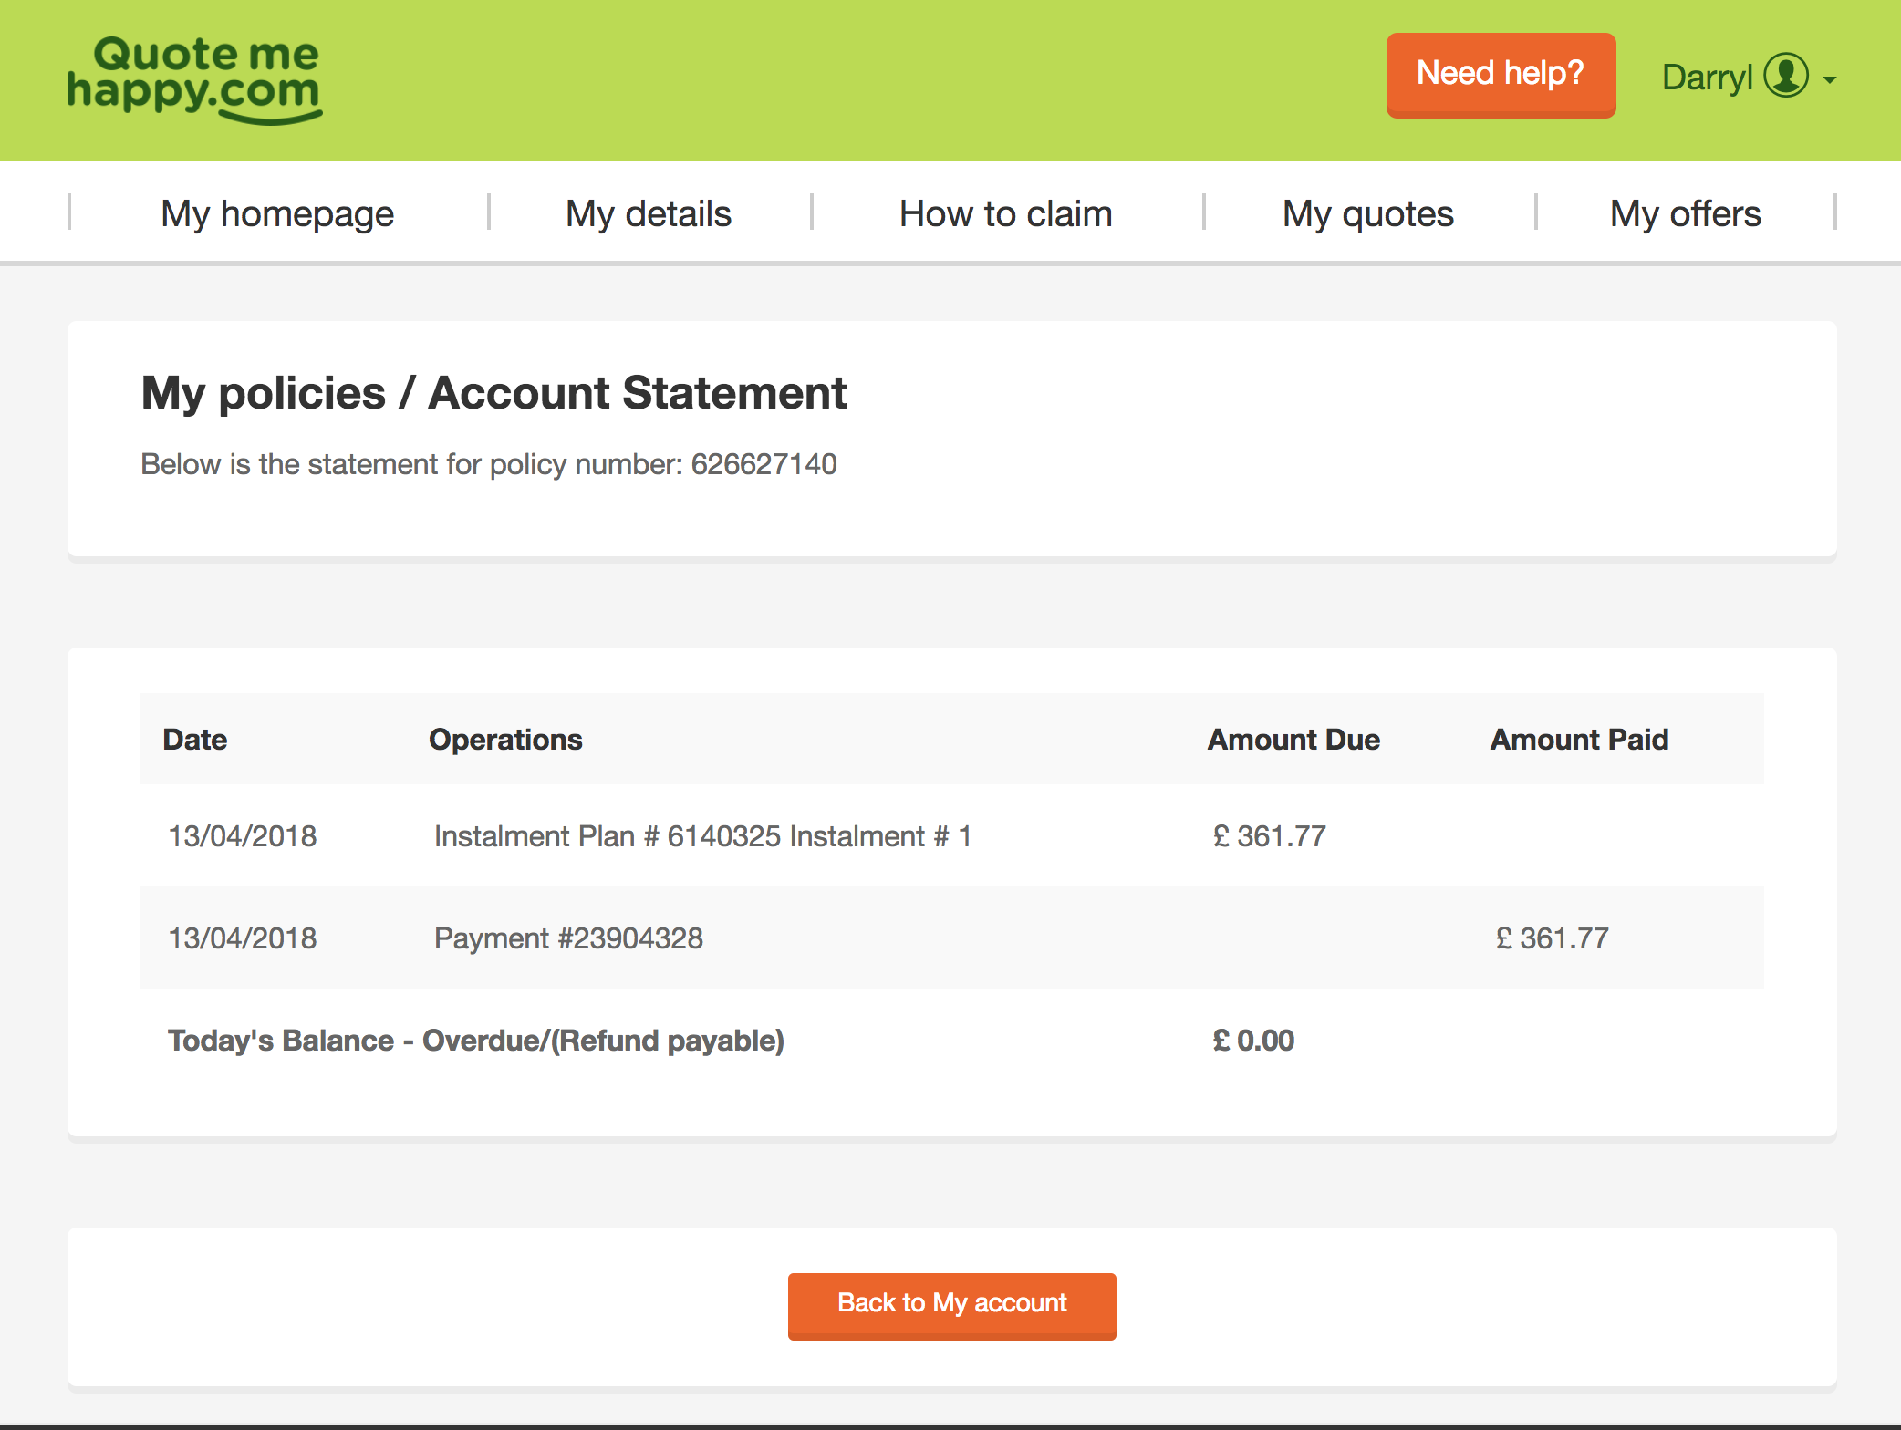
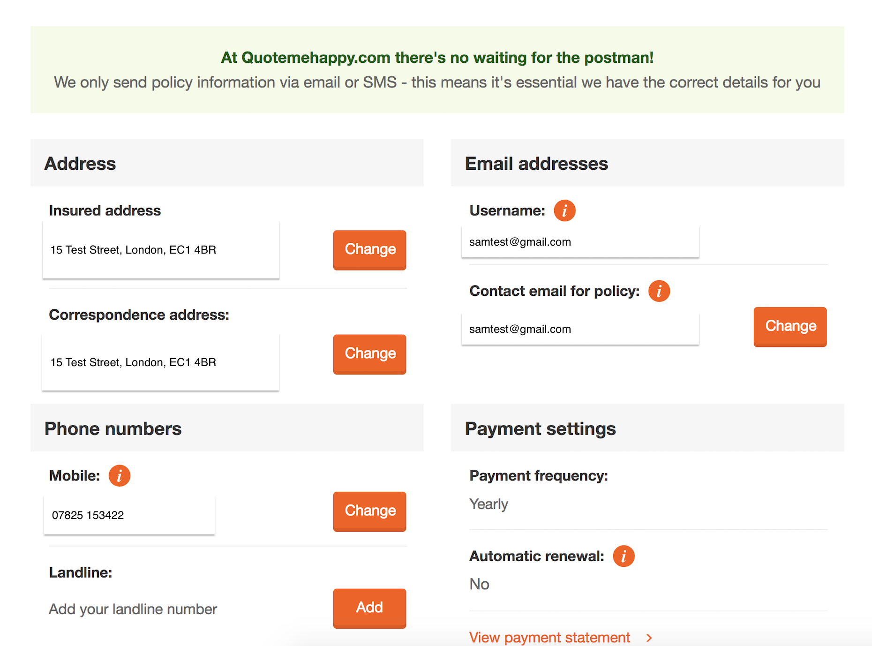
Data examples
Quotemehappy.com

Slide 8
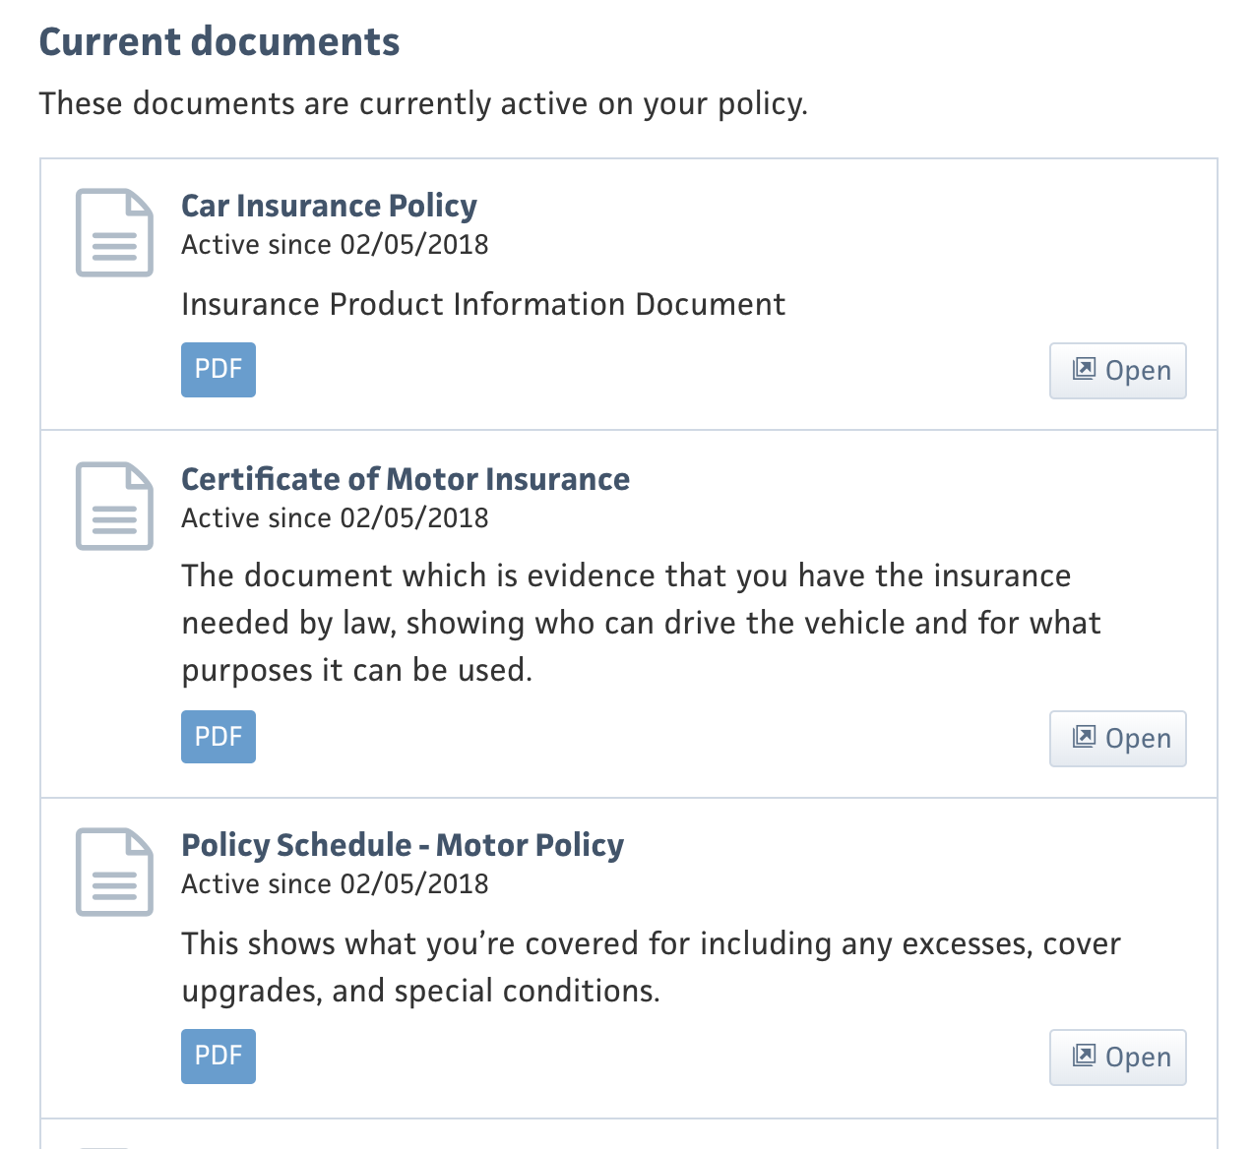
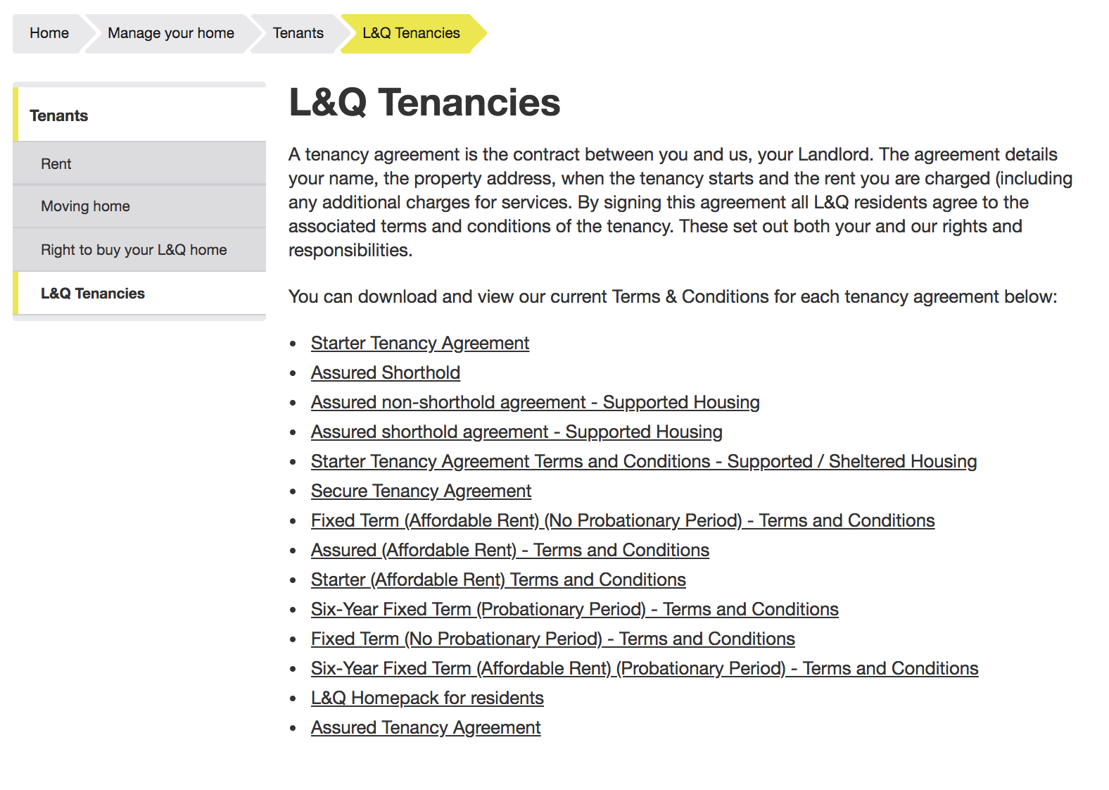
CMS content and PDF link examples
Admiral insurance & L & Q Housing

